Slide 1
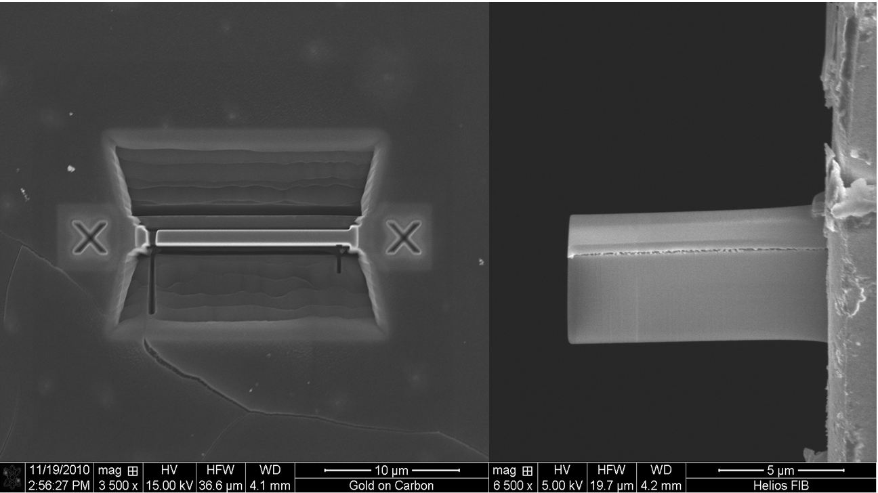
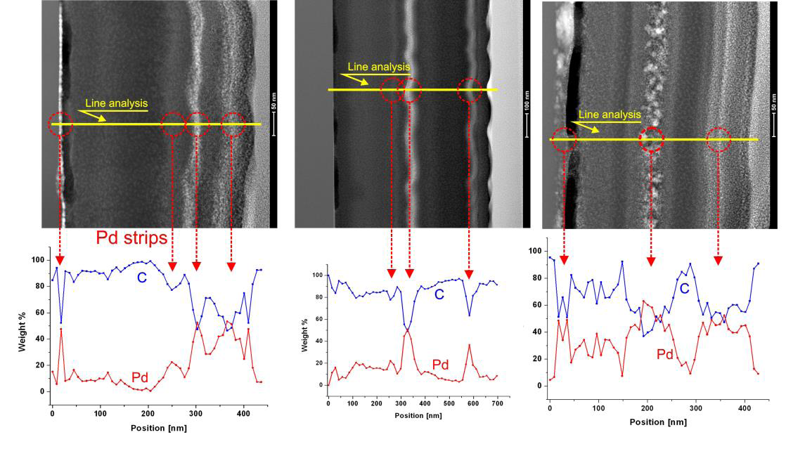
TEM characterization of carbon-palladium nanocomposites dedicated for hydrogen
P.Dłużewski¹, B. Kurowska¹, K.Sobczak¹, M.Kozłowski^{1,2}, E.Czerwosz², J.Rymarczyk²
¹Institut of Physics PASc., 02-668 Warszawa, Al. Lotników 32/46, Poland
²Tele&RadioResearch Institute, Ratuszowa 11, 03-450 Warszawa, Poland
Detection of hydrogen and its compounds is very important issue for a safety problem of green power development. The palladium nano-grains embedded in carbonaceous films are appropriate for this task due to high active surface, electrical and mechanical stability.
Three; C1, C2 and C3 Pd-C films were deposited on quartz plates by PVD method described in papers [1,2]. Fullerenes (C₆₀) and palladium acetate were evaporated during 10 minutes from separated thermal sources at dynamic vacuum (10⁻⁶ mbar). The temperature of palladium acetate source and the distance from substrate to the sources was the same for all films. The temperature of fullerenes source increased from C1 to C3 films.
The cross-sectional specimens for TEM observations were prepared with the use of focused ion beam (FIB) method. All the specimens were studied with Titan Cubed microscope equipped with EDX spectrometer.
.
Specimens preparation with FIB method
.
.
STEM/EDX measurments
Computer simulations
Fig.1 TEM cross-section images for C1, C2 and C3 films (upper row) and concentration line profile of Pd and C obtained from EDX measurement
Fig.2. Results of computer simulations of spontaneous creation of palladium rich layers. The concentration of palladium is proportional to brightens and growth direction from left to right
.
.
The simulation of spontaneous layer’s creation algorithm
CONCLUSION
The all films exhibited spontaneous formation of the palladium rich layers. The thickness of the layers can be controlled with the temperature of fullerene evaporating source. Appropriate choice of ratio of the rate flow of the reactants plays a key role in the segregation process. Simple model of the Pd segregation based on diffusion and nucleation explains some features of the layers` structure. Knowledge of the mechanism of segregation is very useful for the design of the layers used for the detection of hydrogen and its compounds.
Starting parameters:
Diffusion k, nucleation a and m, metal concentration ca
For t=0 to t=T
C_{a}^{t}(i-1)=Ca
For n=0 to n=t
C_{a}^{n}(i)=k*(C_{a}^{n-1}(i-1)+C_{a}^{n} (i-1)+C_{a}^{n+1} (i-1))
C_{b}^{n} (i)=C_{b}^{n-1} (i-1)+a*C_{a}^{n-1} (i)
C(i)=C_{a}(i)-a*m*C_{b}(i)
References
[1] Czerwosz E., Dluzewski P., Gieraltowski W., Sobczak J.W., Starnawska E., Wronka H., J. Vac. Sci. Technol. B18, 2000, 1064
[2] E.Kowalska, E.Czerwosz, M.Kozłowski, W.Surga, J.Radomska, H.Wronka, J.Therm Anal Calorim 101 (2010), 737-742,
For n=0 to n=t
C_{a}^{n}(i)=C_{a}^{n}(i-1)
C_{b}^{n}(i)=C_{b}^{n}(i-1)
ACKNOWLEGMENT
This work is co-founded by the European Regional Development Fund within the Innovative Economy Operational Programme 2007-2013 of the projects: “Development of technology for a new generation of the hydrogen and hydrogen compounds sensor for applications in above normative conditions” No UDA-POIG.01.03.01-14-071/08-09) and „Analitical high-resolution transmission electron microscope for nanotechnology, nanoscience and spintronics” No. POIG.02.01-00-14-032/08
C_{a}^{n} = C_{a}^{n} + C_{b}^{n}

